Slide 1
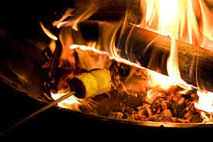
Welcome
Sunday@5

Slide 2
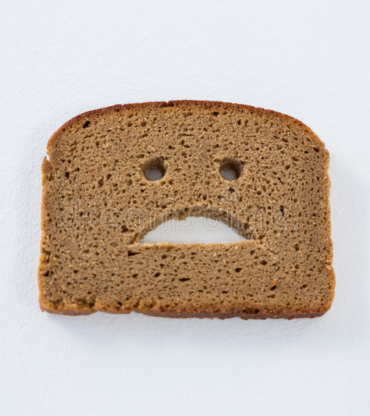

Taskmaster Sunday@5
Using only a slice of bread, make yourself the best eyebrows, beard and moustache then capture yourself in a selfie.
Best beard face wins
You have 5 minutes. Your time starts when the taskmaster rubs their chin.

Slide 3
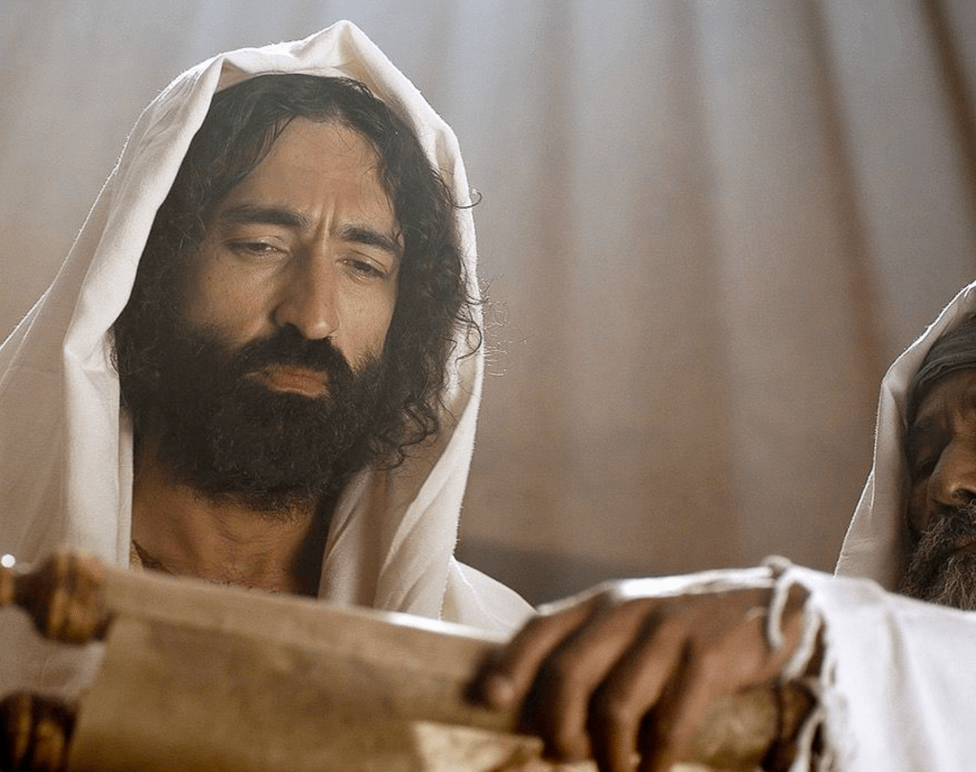
Jesus went to Nazareth, where he had been brought up. And on the sabbath day, he went into the synagogue as was his custom and he stood up to read. The scroll of the prophet, Isaiah was handed to him
Unrolling it he found the place, and began to read…

Slide 4
“The Spirit of the Lord is on me Because he has anointed me to preach good news to the poor He has sent me to bring freedom to the prisoners And recovery of sight for the blind To release the oppressed To declare the year of the Lord’s favour.”

Slide 5
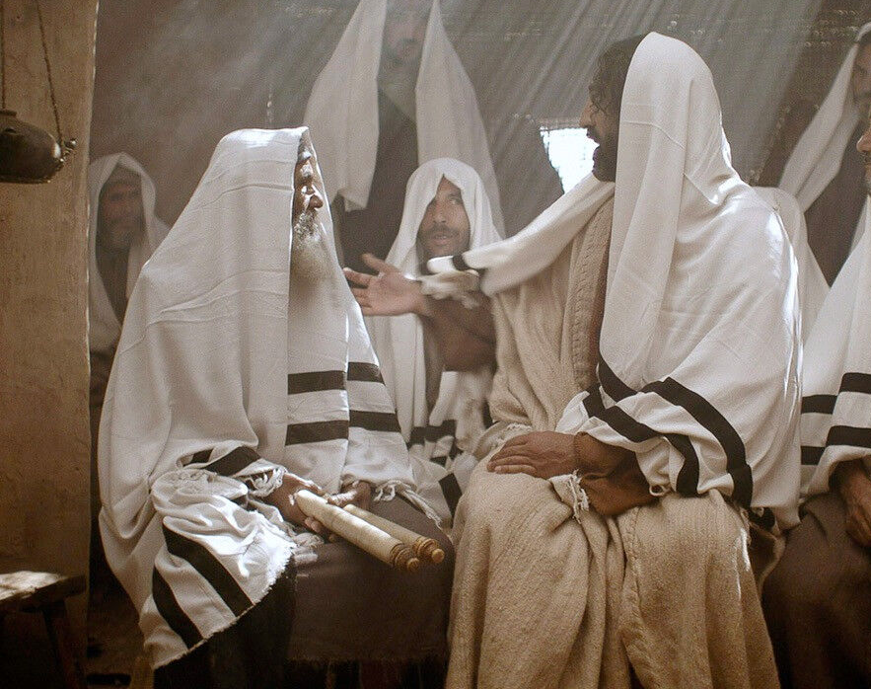
Then he rolled up the scroll, gave it back to the attendant and sat down The eyes of everyone in the synagogue were fixed upon him

Slide 6
He began by saying, “Today this scripture is fulfilled in your hearing”

Slide 7
He began by saying, “Today this scripture is fulfilled in your hearing”

Slide 8
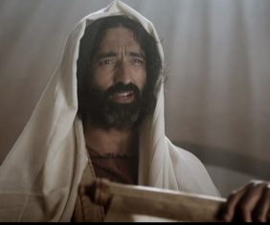
All spoke well of him and were amazed at the gracious words which feel from his lips “But isn’t this Joseph’s son?” they asked. Jesus said to them “Surely you will quote this proverb to me, “Physician heal yourself:” “Do in your hometown what you did in Capernaum”

Slide 9
“I tell you the truth,” he continued. No prophet is ever accepted in his hometown.” “I assure you there were many widows in Israel in Elijah’s day when there was a drought for three and a half years and a famine throughout the country. But Elijah wasn’t sent to any of them, but to a foreign widow in Zarephaph in the region of Sidon”

Slide 10
“And there were loads of people with leprosy in Prophet Elisha’s day, but none of them were healed – just the foreigner Naaman the Syrian”

Slide 11
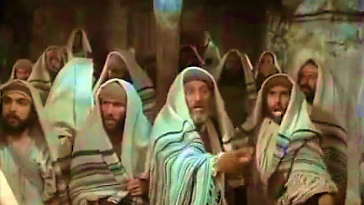
All the people in the synagogue were furious when they heard this They got up Drove him out of the town and took him to the cliff to throw him over the edge But he walked right through the crowd and went on his way

Slide 12
Jesus had to break the mould…

Slide 13
“The Spirit of the Lord is on me Because he has anointed me to preach good news to the poor He has sent me to bring freedom to the prisoners and recovery of sight for the blind to release the oppressed to declare the year of the Lord’s favour.”
This is Jesus’ vision of what his life is all about.
Have a go at writing it in modern terms – turning it into an advert for Jesus – This can be a written advert (use the flip chart) or a performed one. You have 10 minutes.

Slide 14

The splendour of the King (age to age he stands)

Slide 15
"I am who you say I am”

Slide 16
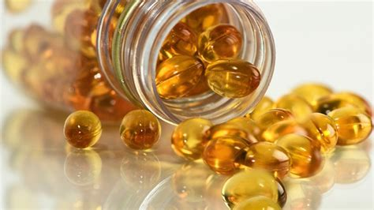
PRAY
Jesus spoke of being “anointed” to do the work God sent him to do. Break open an oil capsule and anoint yourself. Pray for God’s Spirit to be upon you to enable you to be the person God made you to be and do the work God sends you to do”

Slide 17

PRAY
Think about
good news to the poor freedom for prisoners recovery of sight for the blind release for oppressed
A year of God’s favour…
Light a candle and name someone or something you personally want to pray for

Slide 18
Our Father,
who art in heaven
Hallowed be Thy name
Thy Kingdom come: Thy will be done
On earth as it is in heaven
Give us this day our daily bread
And forgive us our trespasses
As we forgive those who trespass against us.
And lead us not into temptation
But deliver us from evil
For thine is the Kingdom, the power and the glory
For ever and ever.
Amen

Slide 19

You are the everlasting God The everlasting God You do not faint:Y ou wont grow weary You are the defender of the weak You comfort those in need You lift us up on wings like eagles

Slide 20
Strength will rise as we wait upon the Lord as we wait upon the Lord as we wait upon the Lord Strength will rise as we wait upon the Lord as we wait upon the Lord as we wait upon the Lord

Slide 21
BLESSING
Sunday@5
Thankyou for coming. May God bless you.
More drinks are available.

